Slide 1
Control Statements/Decision Making

Slide 2
Decision making structures require that the programmer specifies one or more conditions to be evaluated or tested by the program, along with a statement or statements to be executed if the condition is determined to be true, and optionally, other statements to be executed if the condition is determined to be false.

Slide 3
There are the following variants of if statement in C language.
If statement
If-else statement
If else-if ladder
Nested if

Slide 4
If Statement
The if statement is used to check some given condition and perform some operations depending upon the correctness of that condition.
It is mostly used in the scenario where we need to perform the different operations for the different conditions.
The syntax
if(expression){
//code to be executed
}

Slide 5
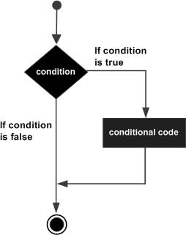
Flow Diagram

Slide 6
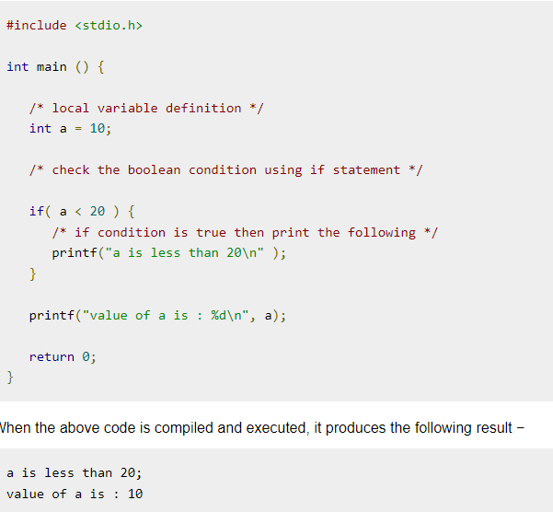

Slide 7
If-else Statement
The if-else statement is used to perform two operations for a single condition.
The if-else statement is an extension to the if statement using which, we can perform two different operations, i.e., one is for the correctness of that condition, and the other is for the incorrectness of the condition.

Slide 8
The syntax of the if-else statement is given below.
if(expression){
//code to be executed if condition is true
}else{
//code to be executed if condition is false
}

Slide 9
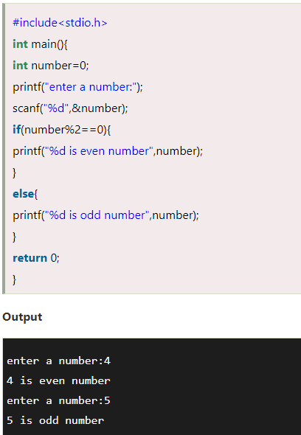

Slide 10
If else-if ladder Statement
The if-else-if ladder statement is an extension to the if-else statement.
It is used in the scenario where there are multiple cases to be performed for different conditions.
In if-else-if ladder statement, if a condition is true then the statements defined in the if block will be executed, otherwise if some other condition is true then the statements defined in the else-if block will be executed, at the last if none of the condition is true then the statements defined in the else block will be executed.

Slide 11
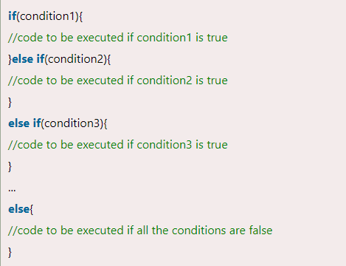

Slide 12
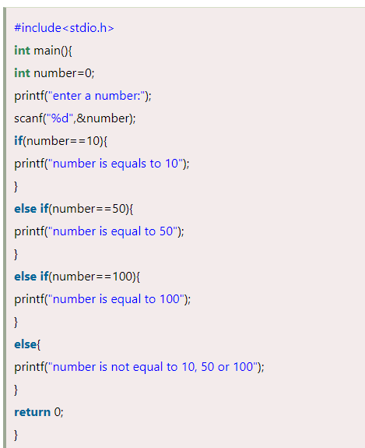

Slide 13
Switch Statement
The switch statement in C is an alternate to if-else-if ladder statement which allows us to execute multiple operations for the different possible values of a single variable called switch variable.
Here, We can define various statements in the multiple cases for the different values of a single variable.

Slide 14
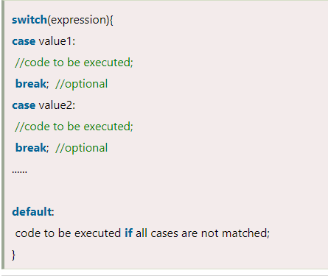

Slide 15
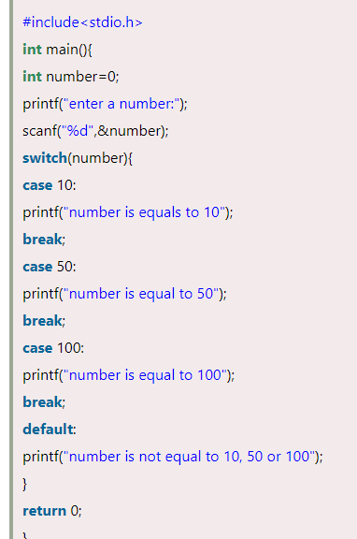

Slide 16
Ternary operator
The ternary operator is a shorthand way to write an if-else statement in many programming languages, including C, C++, and Python. It is also known as the conditional operator because it evaluates a condition and returns one of two values based on the result of that condition.
Syntax of the Ternary Operator
c
condition ? expression1 : expression2;
condition: A boolean expression that is evaluated.
expression1: The value that is returned if the condition is true.
expression2: The value that is returned if the condition is false.
Example in C
int a = 10, b = 20; int max = (a > b) ? a : b;
In this example, the condition (a > b) is checked:
If true, max will be assigned the value of a.
If false, max will be assigned the value of b.
Here, max would be 20 because a > b is false.

Slide 17
Advantages of the Ternary Operator
Conciseness: It allows you to write simple conditional statements in a single line.
Readability: When used appropriately, it can make the code more readable by reducing the need for multiple lines of if-else statements.
When to Use
The ternary operator is best suited for simple conditional assignments or returns where the logic is straightforward.
For more complex conditions or actions, traditional if-else statements might be clearer and easier to understand.

Slide 18
C Loops
The looping can be defined as repeating the same process multiple times until a specific condition satisfies.
Types of C Loops
There are three types of loops in C language that is given below:
do while
while
for

Slide 19
while loop in C
A while loop in C programming repeatedly executes a target statement as long as a given condition is true.
Syntax
The syntax of a while loop in C programming language is −
while(condition) {
statement(s);
}

Slide 20
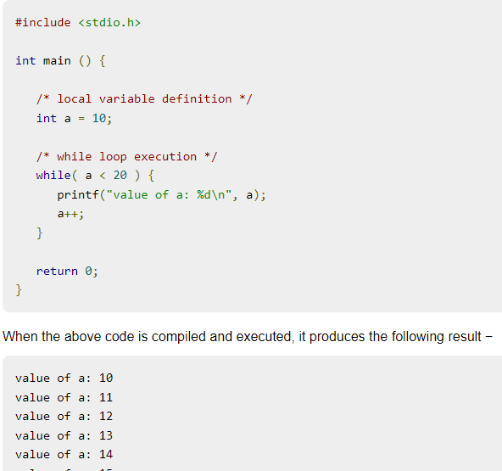

Slide 21
for loop in C
A for loop is a repetition control structure that allows you to efficiently write a loop that needs to execute a specific number of times.
Syntax
The syntax of a for loop in C programming language is −
for ( init; condition; increment ) {
statement(s);
}

Slide 22
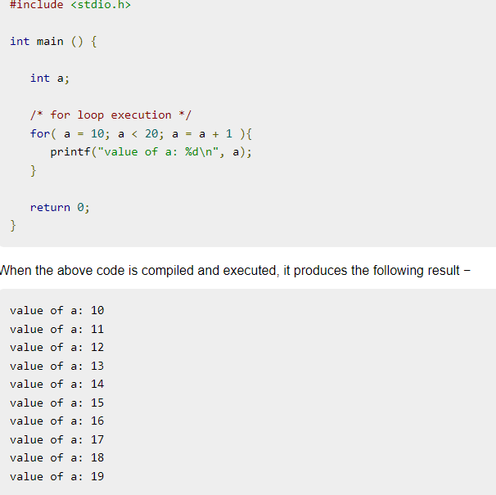

Slide 23
do...while loop in C
Unlike for and while loops, which test the loop condition at the top of the loop, the do...while loop in C programming checks its condition at the bottom of the loop.
A do...while loop is similar to a while loop, except the fact that it is guaranteed to execute at least one time.

Slide 24
The syntax of a do...while loop in C programming language is −
do {
statement(s);
} while( condition );
Notice that the conditional expression appears at the end of the loop, so the statement(s) in the loop executes once before the condition is tested.

Slide 25
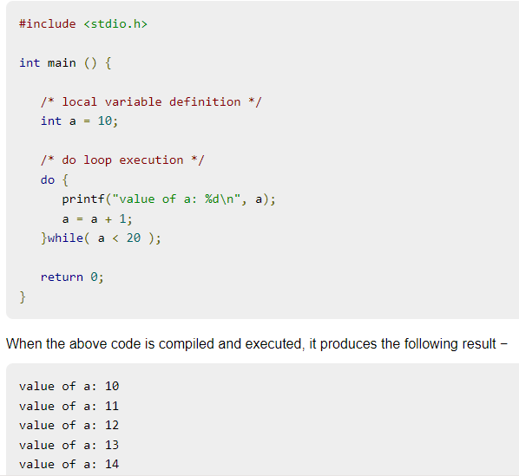

Slide 26
C Comments
Comments can be used to explain code, and to make it more readable. It can also be used to prevent execution when testing alternative code.
Comments can be singled-lined or multi-lined.

Slide 27
Single-line Comments
Single-line comments start with two forward slashes (//).
Any text between // and the end of the line is ignored by the compiler (will not be executed).
This example uses a single-line comment before a line of code:
Example
// This is a comment
printf("Hello World!");

Slide 28
C Multi-line Comments
Multi-line comments start with /* and ends with */.
Any text between /* and */ will be ignored by the compiler:
Example
/* The code below will print the words Hello World!
to the screen, and it is amazing */
printf("Hello World!");

Slide 29
break statement
The break is a keyword in C which is used to bring the program control out of the loop.
The break statement is used inside loops or switch statement. The break statement breaks the loop one by one, i.e., in the case of nested loops, it breaks the inner loop first and then proceeds to outer loops.
The break statement in C can be used in the following two scenarios:
With switch case
With loop

Slide 30
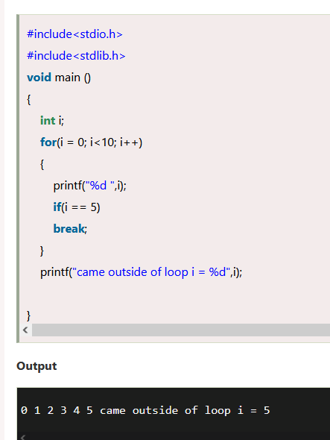

Slide 31
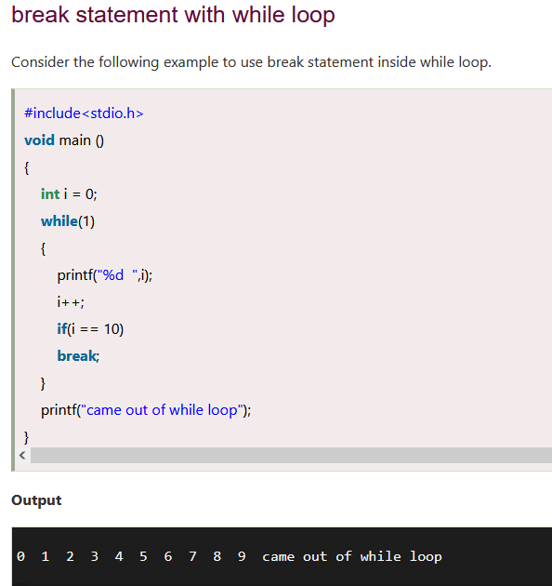

Slide 32
continue statement
The continue statement in C language is used to bring the program control to the beginning of the loop.
The continue statement skips some lines of code inside the loop and continues with the next iteration.
It is mainly used for a condition so that we can skip some code for a particular condition.

Slide 33
